Slide 1
Data Mining
Reference Books:
1) Introduction to Data Mining
Author: P N Tan, M Steinbach and V Kumar
2) Data Mining: Concepts and Techniques
Author: J Han and M Kamber

Slide 2
Association Analysis
Association analysis
It is a methodology which is useful for discovering interesting relationships hidden in large data sets
The uncovered relationships can be represented in the form of association rules or sets of frequent items
E.g. The rule {Bread, Sweet} → {Milk} can be extracted from Table 1
Applications
Market basket analysis, Bioinformatics, Medical diagnosis, Web mining, and scientific data analysis.
Support count
The support count for an item set X is σ(X) which refers to the number of transactions that contain item set X. The support count for the item set
    {Bread, Sweet, Milk} is 2.
TID | Items
1 | {Bread, Milk}
2 | {Diapers, Rice, Milk, Beer}
3 | {Bread, Sweet, Milk, Beer}
4 | {Bread, Sweet, Milk, Beef}
N = 4
X ={Bread, Sweet}
Y = {Milk}
s(X → Y) = σ(X ∪ Y) / N
= σ({Bread,Sweet} ∪ {Milk})/N
= σ({Bread,Sweet,Milk})/N
= 2/4=0.5
Or 50%
s=0.5
c(X → Y) = σ(X ∪ Y) / σ(X) = 2/2=1, or 100%

Slide 3
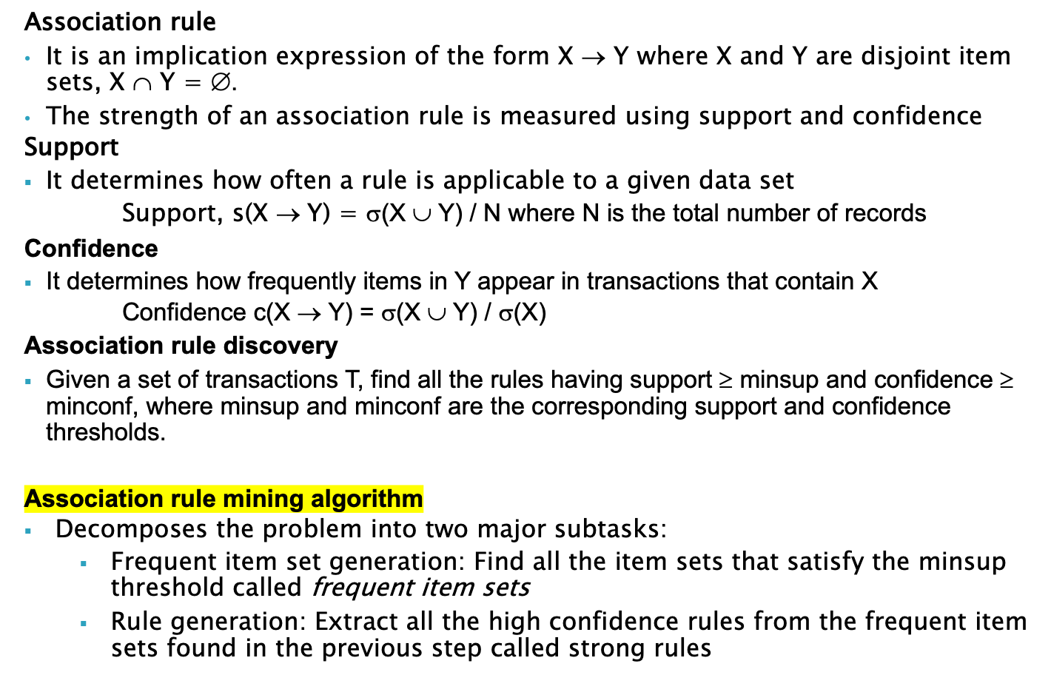
Association Analysis

Slide 4
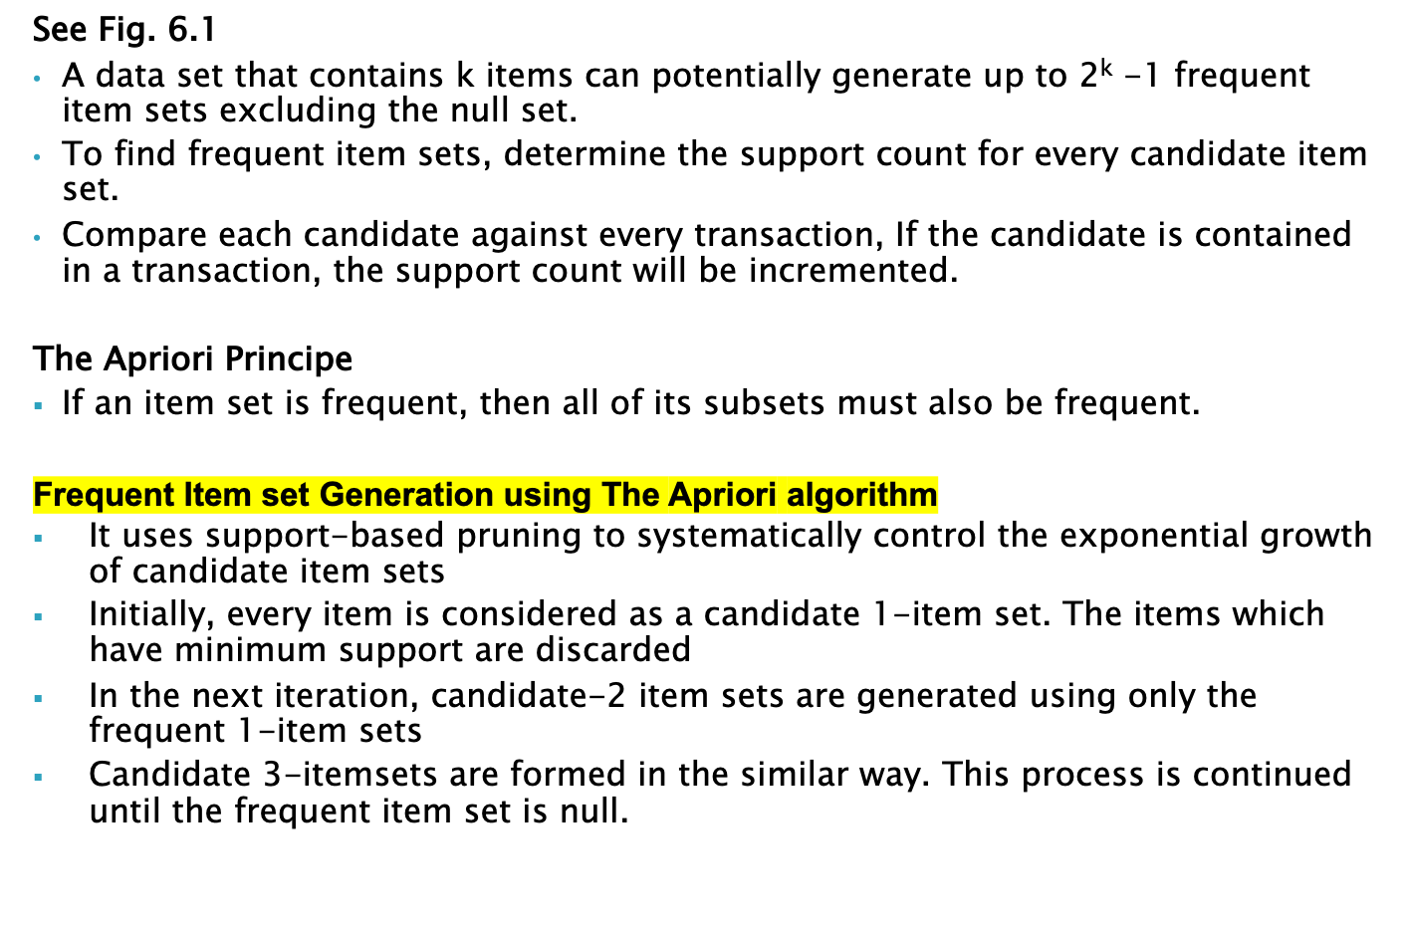
Association Analysis

Slide 5
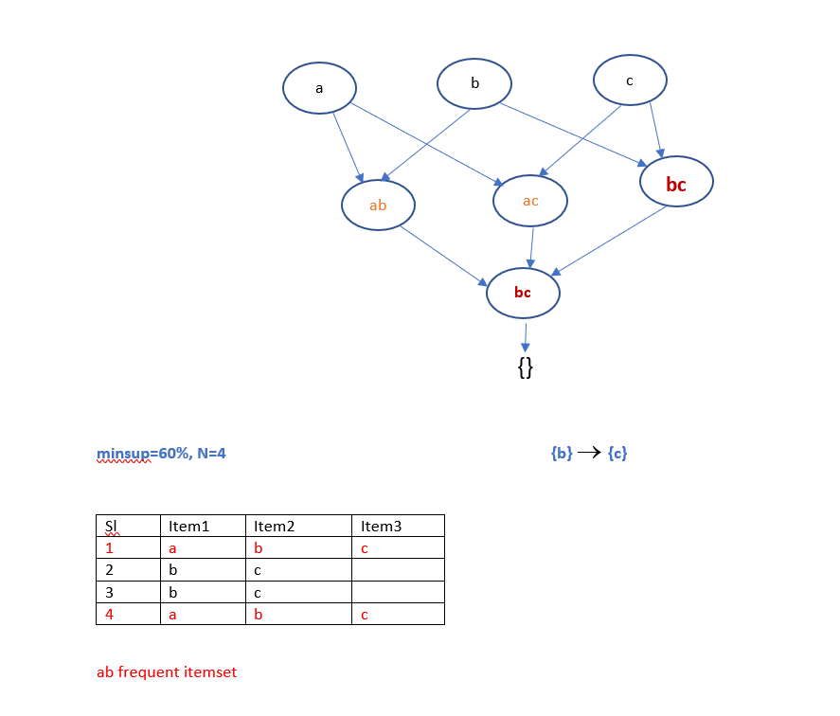

Slide 6
Association Analysis
Frequent Item set Generation using The Apriori algorithm
The following variables are used in the Apriori algorithm:
C_{k} → denotes the set of candidate k-item sets
F_{k} → denotes the set of frequent k-item sets
The algorithm initially makes a single pass over the data set to determine the support of each item. Upon completion of this step, the set of all frequent 1-itemsets, F₁ will be known (step 1 and 2)
The algorithm will iteratively generate new candidate k-itemsets using the frequent (k-1)-itemsets found in the previous iteration (step 5).
Candidate generation is implemented using a function called apriori-gen()
See Algorithm 6.1 Frequent itemset generation of the Apriori algorithm
To count the support of the candidates, the algorithm needs to make an additional pass over the data set (step 6-10). The subset function is used to determine all the candidate itemsets in C_{k} that are contained in each transaction t.
The algorithm eliminates all candidate itemsets whose support counts are less than minsup (step 12).
The algorithm terminates when there are no new frequent itemsets generated,
F_{k} = ∅ (step 13)
Total number of iterations = k_{max} +1 where k_{max} is the maximum size of the frequent itemsets.

Slide 7
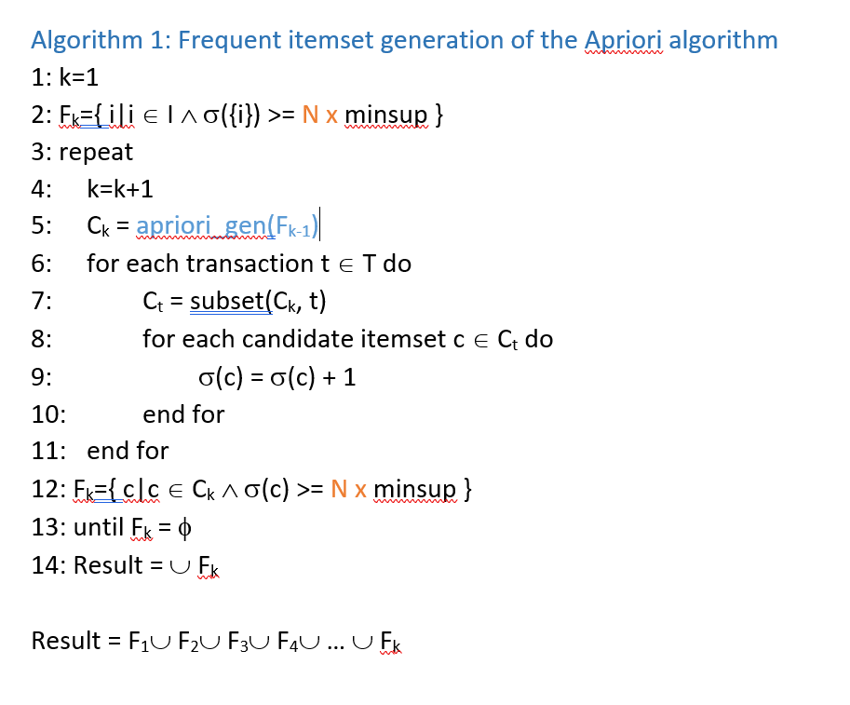

Slide 8
Association Analysis
Candidate Generation and Pruning
The apriori-gen() function generates candidate itemsets by performing the following two functions:
  Candidate generation: it generates new candidate k-itemsets based upon the frequent (k-1) itemsets found in the previous iteration
  Candidate pruning: This operation eliminates some of the candidate k-itemsets using the support-based pruning strategy. The infrequent item is immediately prunned.
Rule Generation
The ap-genrules() function generates the rules which are strong
See Algorithm 6.2 Rule generation of the Apriori algorithm
See Algorithm 6.3 Procedure ap-genrules()

Slide 9
It describes how to extract association rules efficiently from a given frequent itemsets
Y is a frequent k-itemset
If we make X and Y-X two partitions of Y, then X → Y-X is a rule

Slide 10
Algorithm 6.2: Rule generation of the Apriori algorithm
1: for each frequent k-itemset f_{k}, k≥2 do
2: H₁= {i|i∈f_{k}}
3: call ap-genrules(f_{k},H₁)
4: end for
Rule: {bc} → {ad}

Slide 11
Algorithm 6.3 Procedure ap-genrules(f_{k}, H_{m})
1: k=|f_{k}|
2: m=|H_{m}|
3: if k>m+1 then
4: …….
5: for each h_{m+1} ∈ H_{m+1}
6: …….
7: if conf>= minconf then
8: output the rule (f_{k} - h_{m+1}) → h_{m+1}
9: else
10: delete h_{m+1} from H_{m+1}
11: endif
12: …….
{abcde}. h_{m}=cd; Rule: {abe} → {cd}

